Slide 1

Case Study NYC Bikes Analysis

Slide 2
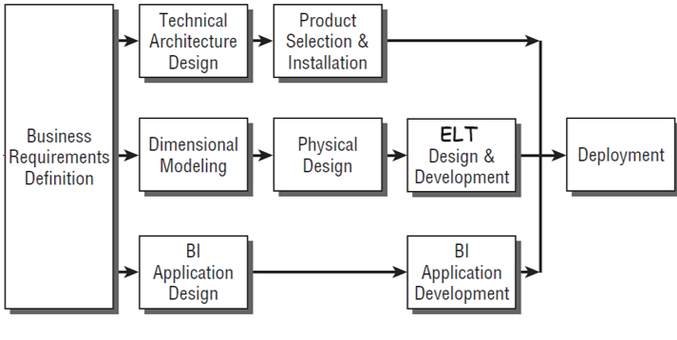
Kimball DW/BI Lifecycle

Slide 3
Business Requirements Definition

Slide 4

Understanding Business Requirements
The number of trips during particular periods
Bikes Usage
The average trip duration/distance within a specific period of time
The number of trips by weather condition
Weather condition

Slide 5
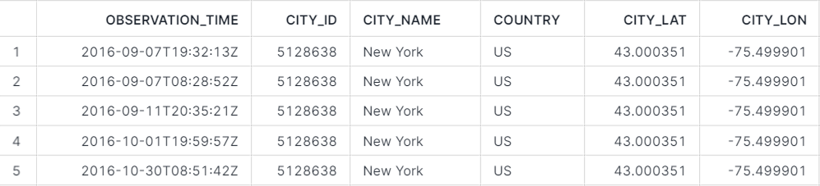
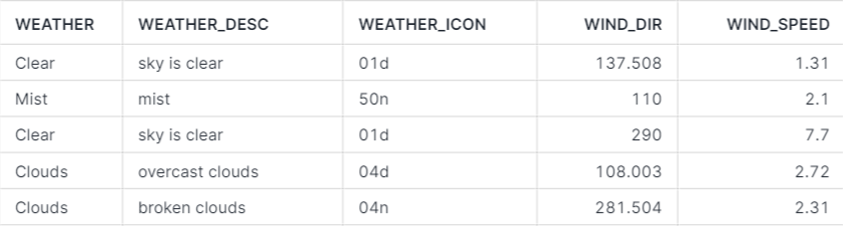
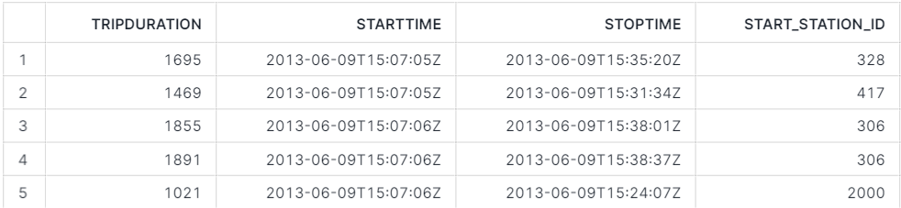
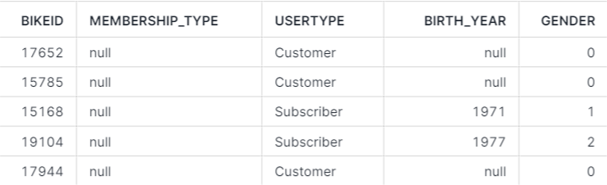
Understanding Data Realities
Data Profiling
Weather data
S3 bucket: s3://snowflake-workshop-lab/weather-nyc
Bike data
S3 bucket: s3://snowflake-workshop-lab/citibike-trips

Slide 6
Technical Architecture Design

Slide 7

Technical Architecture Design
External
Data Sources
Raw Data
Prepared Data
Report
Ingest
Transform
Analyze

Slide 8
Product Selection & Installation

Slide 9




Product Selection & Installation
External
Data Sources
Raw Data
Prepared Data
Report
EL
T

Slide 10
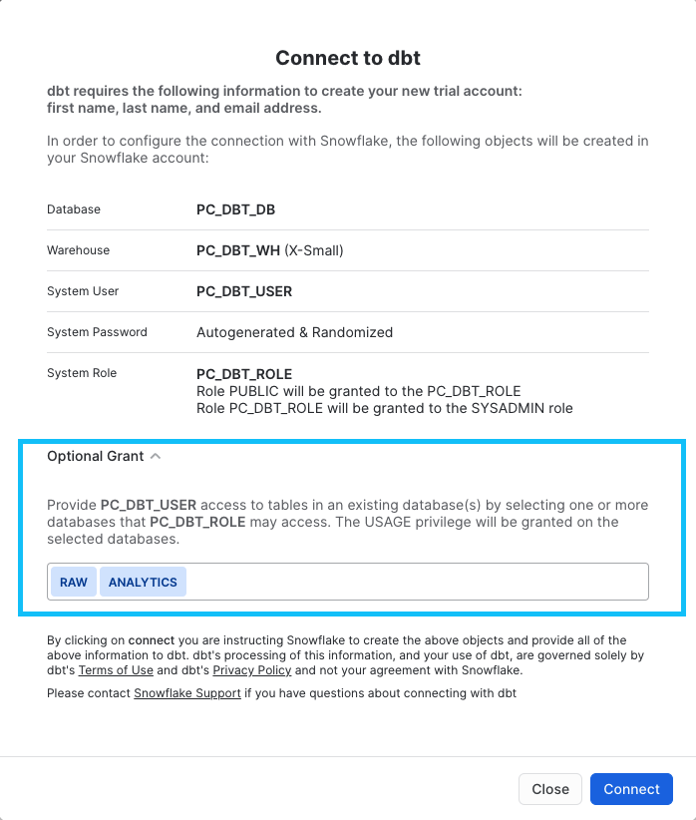
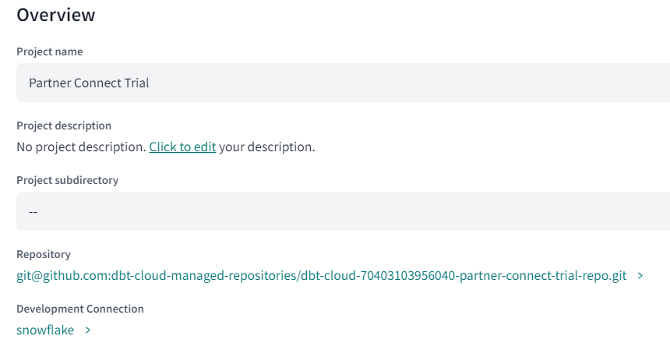
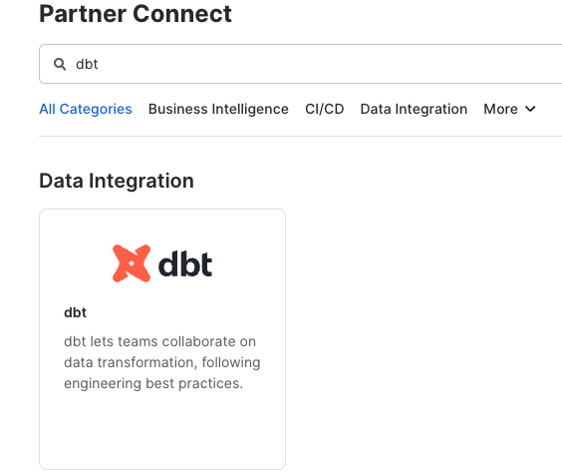
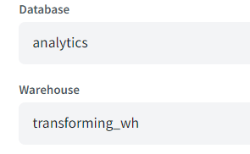
Dbt Cloud – Connect to Snowflake via Partner Connect
Step 1
Step 2
Step 3

Slide 11
Dimensional Modeling

Slide 12
Dimensional Modeling
Dimension
Weather
Fact
Trips

Slide 13
Physical Design

Slide 14


Physical Design – Creating the Databases, Schemas, Tables
Creating the Warehouse
Create the Databases
Create the Schemas
Create the Tables

Slide 15
ELT Design & Development

Slide 16


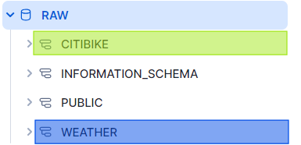
ELT Design & Development – Ingesting the Data
Create Stages
Weather
Create External
EL
Ingest Data into Corresponding Tables
City Bike

Slide 17
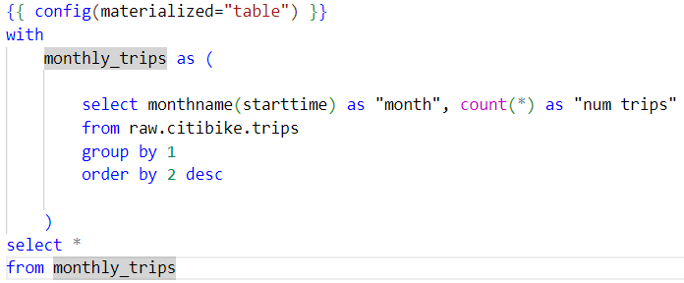
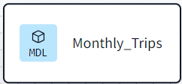
ELT Design & Development – Building the Models
The number of trips within months
Trips
Monthly_Trips
T

Slide 18
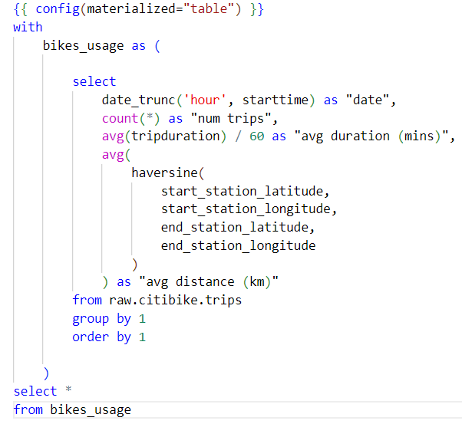
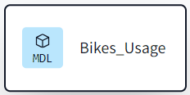
ELT Design & Development – Building the Models
The average trip duration/distance within a specific period of time
Trips
Bikes_Usage
T

Slide 19
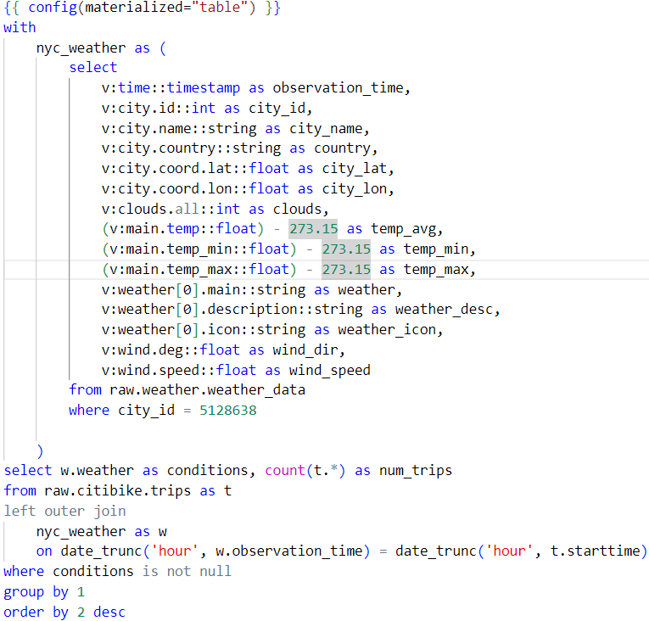
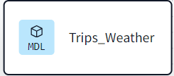
ELT Design & Development – Building the Models
The number of trips by weather condition
Trips
Bikes_Usage
T
Weather

Slide 20
BI Application Design & Development

Slide 21
BI Application Design & Development
The number of trips within months:
Are bikes used more in February or June, or September maybe?
The average trip duration/distance within a specific period of time
Are trips longer in February compared to June?
The number of trips by weather condition:
Are bikes used more when the weather is sunny or rainy?

Slide 22
Deployment

Slide 23
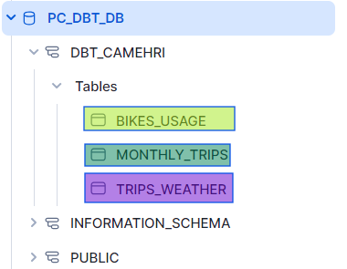
Deployment
External
Data Sources
Raw Data
Prepared Data
EL
T

Slide 24
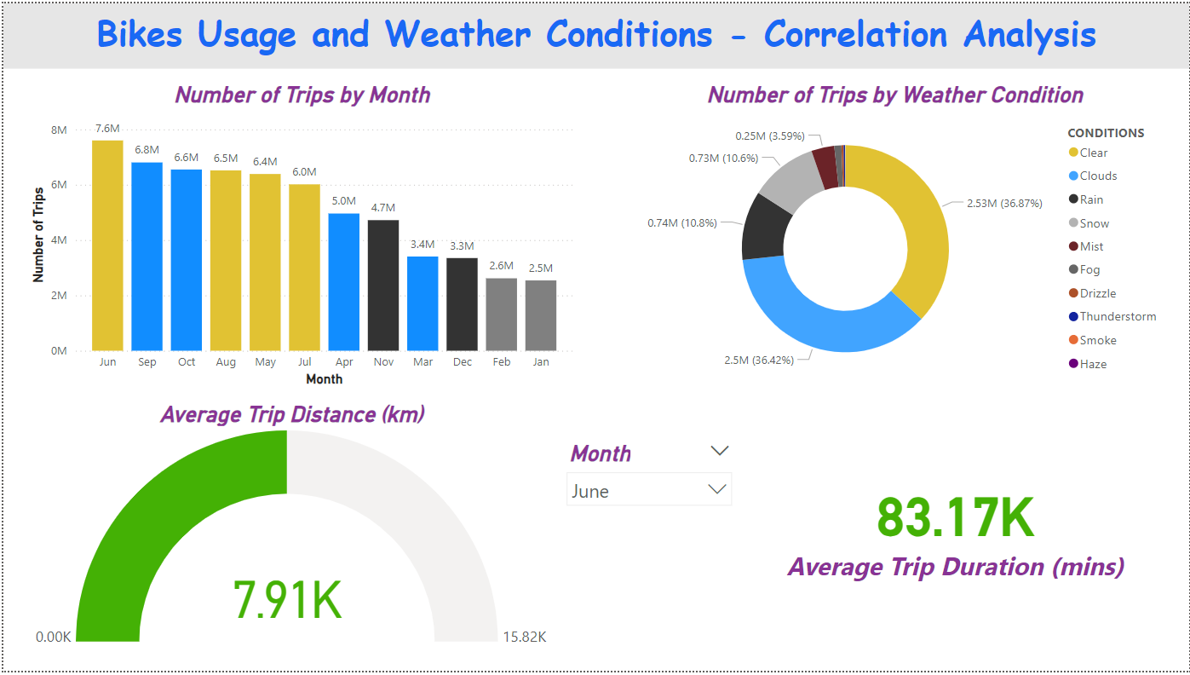
Deployment

Slide 25
Further Considerations – Dimensional Model

Slide 26
Further Considerations – Dimensional Model
DIM_GEOGRAPHY
DIM_STATIONS
DIM_MEMBERSHIP
DIM_WEATHER
FACT_TRIPS
DIM_USERS
DIM_DATE
DIM_BIKES

Slide 27


Further Considerations – Physical Design
Operational Source System
Defining an Indexing Strategy
DW/BI System
Defining a Partitioning strategy
Select an appropriate Partition Key
E.g., Day
Avoid Data Skew/Hot Partitions
Defining a Clustering strategy
Select an appropriate Clustering Field
E.g., City

